Slide 1
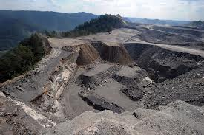
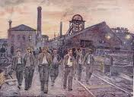
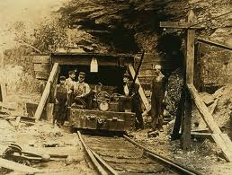
Working In A Coal Mine…
By Kyla Squire &
Sydney Layman

Slide 2
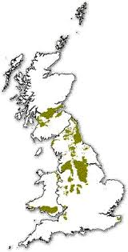
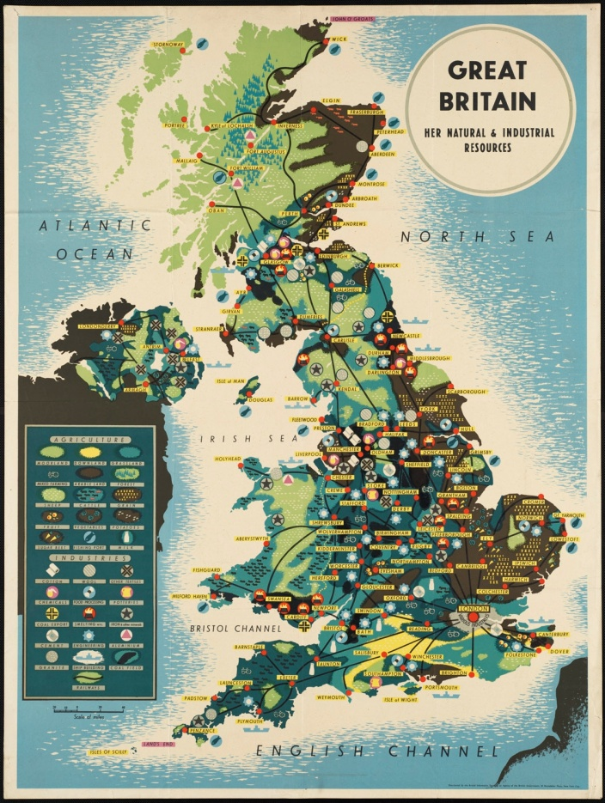
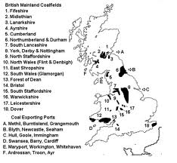
Mines In The Olden Days
Maps Of Britain Coal mines-

Slide 3
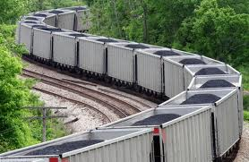
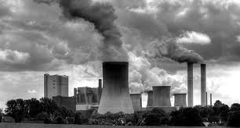
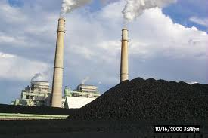
The Uses For Coal
Coal was used as an energy source for heat and electricity.
Coal was used heavily to heat houses and power factories and locomotives.
most of the exported coal was used for making steel

Slide 4
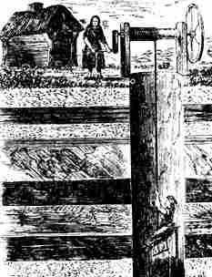
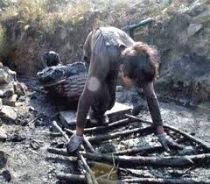
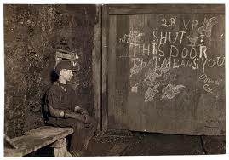
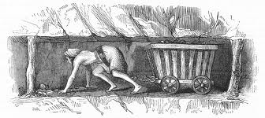
.
The People Who Worked In The Coal Mine
At first, women and children worked alongside men in the coal mines. Before 1842, there were no protection laws, nor limits for the age of child labor, so many children (mostly boys) were found working under the age of 10, along with pregnant women working in the mines. Children, boys and girls were forced to drag the coal up through the small pass ways to the top. They did this by having a chain attached at their waist to drag bins of heavy coal. Women also had to pull the men up from the mine (picture in bottom right). Boys did the job of opening and shutting wooden doors to let air through the tunnels. This is called a ‘trapper ‘ and they sat in the dark, with just a small candle-nobody to talk to.

Slide 5
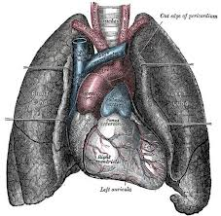
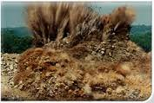
.
DANGERS.
The were many awful diseases men, women and children could get or suffer from, while working in the mines.
Here are a few of them:
Black lung disease
The coal dust got in your lung turning them black and killing you.
suffocation, gas poisoning, roof collapse and gas explosions can lead to fatal endings
Heart failure

Slide 6
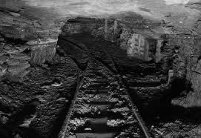
What to do with the dead…
The mining companies didn’t particularly care if somebody died. They usually threw the dead bodies down a mine shaft or if they died down in the mine, they just left them. Although, if they were lucky and died at the top and they had family, they bodies would be taken to their family.

Slide 7
21st century mining
Bhp

