Slide 1
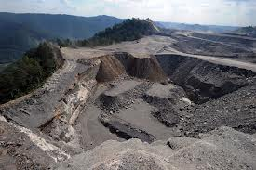
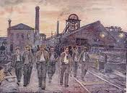
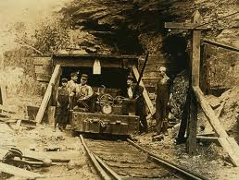
Working In A Coal Mine…
By Kyla Squire &
Sydney Layman

Slide 2
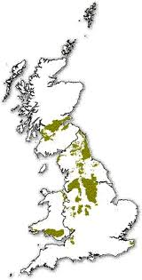
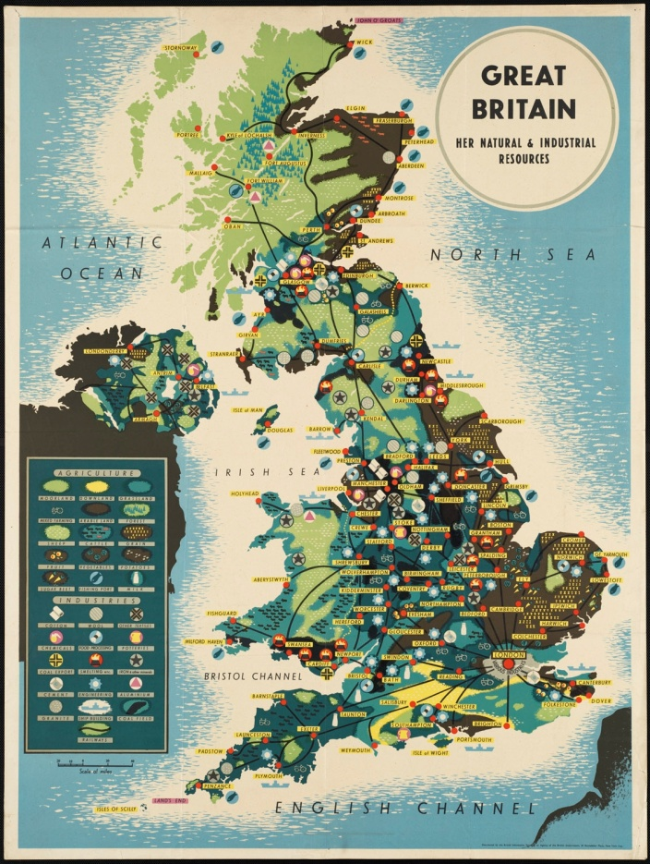
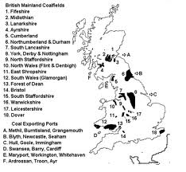
Mines In The Olden Days
Maps Of Britain Coal mines-

Slide 3
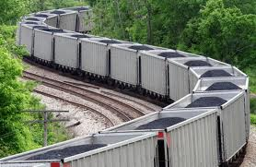
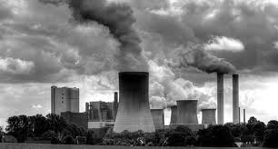
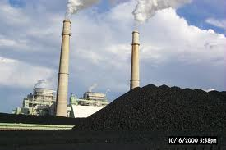
The Uses For Coal
Coal was used as an energy source for heat and electricity.
Coal was used heavily to heat houses and power factories and locomotives.
most of the exported coal was used for making steel

Slide 4
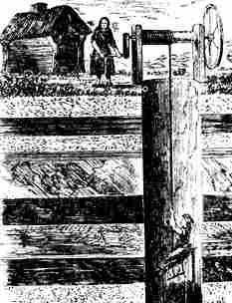
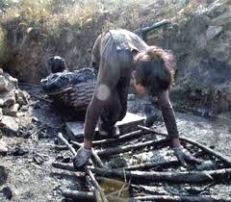
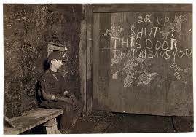
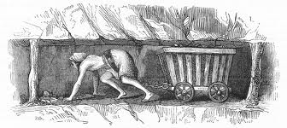
.
The People Who Worked In The Coal Mine
At first, women and children worked alongside men in the coal mines. Before 1842, there were no protection laws, nor limits for the age of child labor, so many children (mostly boys) were found working under the age of 10, along with pregnant women working in the mines. Children, boys and girls were forced to drag the coal up through the small pass ways to the top. They did this by having a chain attached at their waist to drag bins of heavy coal. Women also had to pull the men up from the mine (picture in bottom right). Boys did the job of opening and shutting wooden doors to let air through the tunnels. This is called a ‘trapper ‘ and they sat in the dark, with just a small candle-nobody to talk to.

Slide 5
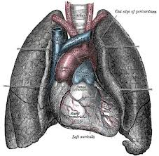
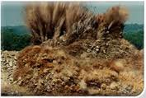
.
DANGERS.
The were many awful diseases men, women and children could get or suffer from, while working in the mines.
Here are a few of them:
Black lung disease
The coal dust got in your lung turning them black and killing you.
suffocation, gas poisoning, roof collapse and gas explosions can lead to fatal endings
Heart failure

Slide 6
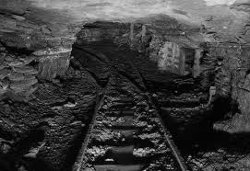
What to do with the dead…
The mining companies didn’t particularly care if somebody died. They usually threw the dead bodies down a mine shaft or if they died down in the mine, they just left them. Although, if they were lucky and died at the top and they had family, they bodies would be taken to their family.

Slide 7
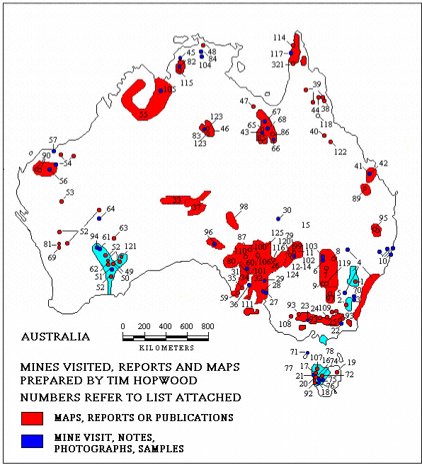
21st century mining
BHP Billiton-a mining company found all over the world but the most popular mine is located in Australia. BHP mines for silver, gold, aluminum, diamonds, energy coal, iron ore, manganese, metallurgical coal, petroleum, and uranium. They are worth 72.22 Billion dollars!

Slide 8
Who works in the mines?
BHP is found all over the world, in many different countries, so the age limit and gender may vary. For example, in Africa (a third world country) you may find small children and women working in the mines, but in a place like Australia you may find fit men over the age of 18 working in the mines.

Slide 9
Union-the act of uniting two or more things.
labor unions represent solidarity among the working classes. They bring people together across many professions to lobby for better rights, wages, and benefits.

Slide 10
Non-union
People who work in a “non-Union” are willing to work for a lower wage, and safety. The union disagrees with this and is willing to do anything to make sure the non-union does not get to work, like slashing tires.

Slide 11
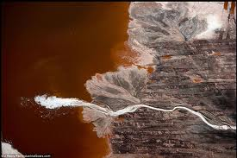
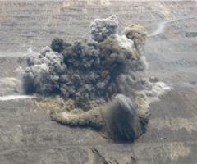
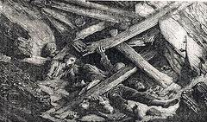
The dangers of today
Cave-ins are one of the most common mining accidents, caused when the walls of the mine collapse, crushing you.
Gas explosions often occur when there is build up of methane gas, this can blow you to bits.
Chemical leaks occur when the chemicals are not securely stored.

Slide 12
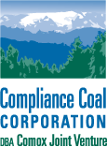
Today-Vancouver Island Mining
The Raven Underground Coal Project (TRUCP)- this is a mine that is going to be located in Comox valley. It is supposed to produce approximately 30 million tonnes (mt) over the 16 year expected life of the mine. 13.2 mt will be shipped to
markets, and 16.8 mt will
remain at the
mine site as wastes.

Slide 13
Benefits of TRUCP
People will want ot work at this new mine because they will make approximately $115 700 a year. 350 well paid employees will be hired. This mine can give many people a job improving British Columbia.

Slide 14
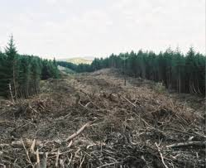
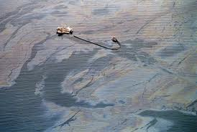
Dangers to the environment
The Raven Underground Coal Project could have major effects on fisheries and forestry companies. Gas leaks can seep into the water killing many fish. The mine can take up a lot of space, forcing trees to be cut down.

Slide 15
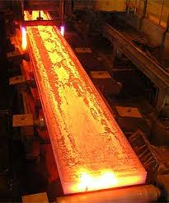
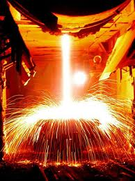
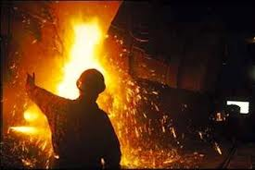
Steel requires a melting process so that mean you would need a factory of some sort. The raven underground coal project would need to build one nearby if they were planning on making steel.

Slide 16
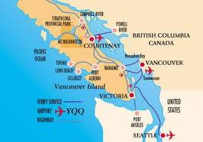
Roberta Stevenson
Stevenson says they are “growing $28 million worth of products right off here, just here in Comox valley and we see that us our number one risk.”

Slide 17
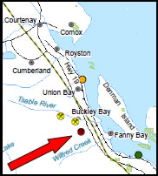
The coast along Buckley Bay and Fanny Bay will be affected by the raven underground coal project.

Slide 18
Opening of the mine- Yes or No?
We think opening The Raven Underground Coal Project would not be a good idea. For us, this project does not effect us because we are not in the need for a job, but if they did open it it could effect our ocean and our forest so there fore we are against opening it!

